Slide 1



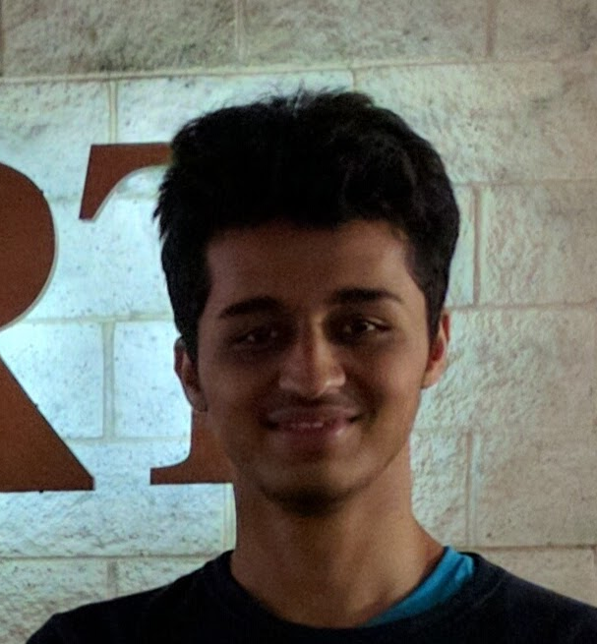
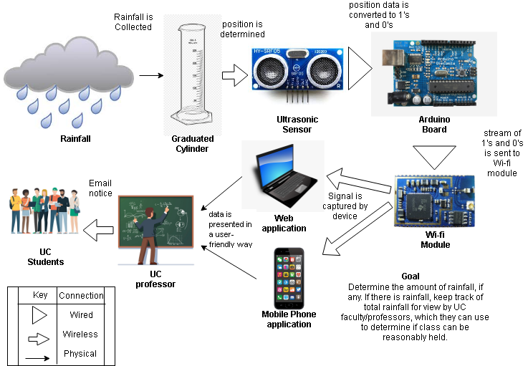







Problem
UC RAINFALL
User Interface
Analysis
Currently, there is not an accurate way to determine the amount of rainfall and erosion experienced by structures on UC’s campus.
Advisor: Fred Annexstine
Smit Patel
Jessica Doyal
Collin Fox
Prathamesh Brahmankar
Design Plan
Solution
Figure 2: User Interface
Currently, there is not an accurate way to determine the amount of rainfall and erosion experienced by structures on UC’s campus.
Results
Figure 1: Design Diagram
Development
Challenges & Accomplishments
Future Plans
We began our project by connecting the hardware components. Our design consisted of a graduated cylinder to collect rainwater, ultrasonic sensors to measure the water level, a Raspberry Pi, and a Wi-Fi module to transmit the data to an online database. The accessible database will be projected in our main web application using HTML, CSS, and JavaScript. Python will be used for the mobile application so the users can see the live readings.
Security: will the sensor be broken if left on campus?
Login details: are we allowed to access 6+2 database?
Legal: are we allowed to place a rainfall sensor on campus?
Enhance mobile and web app user experience
Expand to more college campuses and communities
Make the mobile app available in the Apple App store and Google Play store

